Slide 1

The data class a.k.a. the Pandas class (but it’s not)
Pietro Berkes & Verjinia Metodieva

Slide 2
What are data structures?
Not in a slide, this is an interactive part
Which data structures do you know? write down, start with the ones they use 90% of the time, ask for more exotic ones
You could store data in a dictionary as a list — what makes you choose a data structure over another?
What are the things you need to take into account when thinking about data?

Slide 3
What problems do you encounter with data?
This is an open question to the class
Processing
Storage
Reproducibility and collaboration
Efficient processing (no for-loops!)
Organizing data so that analyses are easy
Size
Access ease
Access time
Versioning
Lineage tracing (which script / other data was used to generate this?)
Ease of sharing
These are criteria for selecting a data structure

Slide 4
All the data structures
list: ordered, heterogeneous storage, stack/queue, fast access by index, slow search
set: unordered
dictionary
arrays: e.g. numpy, HDF5
tables: e.g. pandas, dask, spark, SQL
graph: social network structure
tree: to rapidly search a dataset
heap
stack
queue
priority queue

Slide 5
Hands-on (interactive)
what data structure would you use to represent
a graph? A: either a dictionary or a numpy array (adjacency matrix)
a sound wave?
have a look at Advent of Code to find other examples

Slide 6
How do we think about scaling in performance in data structures? Or in algorithms in general
You developed your code on a small data set, how is it going to scale to the complete data set?
What counts is how the computing time scales as the data becomes larger! That’s by far the dominating factor. We’re interested in order of magnitude.
Development data
Real data
N data points,
Processing time T
10x N data points
Processing time -> ?

Slide 7

How performance scales: big-O
Big-O class | What we call it | How time increases when the data increases 10x | Operation on lists that scales this way
O(1) | constant | 1x time
O(n) | linear | 10x time
O(n^2) | quadratic | 100x time
O(n * log n) | linearithmic | ~10-20x time
O(log n) | logarithmic | ~1-2x time
Fill this column with them: can you think of any operation on lists that scales this way?
VM: add plot with scaling for all of the Big-O classes above

Slide 8
How performance scales: big-O
Big-O class | What we call it | How time increases when the data increases 10x | Operation on lists that scales this way
O(1) | constant | 1x time | Getting first element
O(n) | linear | 10x time | Summing data in list
O(n^2) | quadratic | 100x time | Computing the distance between all pairs os elements in the list (double for-loop through list)
O(n * log n) | linearithmic | ~10-20x time | Sorting the list
O(log n) | logarithmic | ~1-2x time | Searching an element in a sorted list

Slide 9
How performance scales: big-O
Big-O class | What we call it | How time increases when the data increases 10x | Operation on lists that scales this way
O(1) | constant | 1x time | Getting first element
O(n) | linear | 10x time | Summing data in list
O(n^2) | quadratic | 100x time | Double for-loop through list, e.g. create a matrix with the difference of every pair of elements
O(n * log n) | linearithmic | ~10-20x time | Sorting the list
O(log n) | logarithmic | ~1-2x time | Searching an element in a sorted list
Question: how does parallelization, or re-writing the code in a faster programming language, influence the performance?
E.g. parallelize O(n^2) problem
In general we need to distinguish between “fast” in absolute terms for a fixed problem size, and “fast” in the sense of how well it scales

Slide 10

VM: please work on this slide
Fast code
O(n^2)
Regular code
O(n)
Regular code
O(n)
Fast code
(parallel, Cython)
O(n^2)

Slide 11

Example: Find common words
VM: should we have these slides as an interactive Jupyter notebook?
Problem: given two lists of words, extract all the words that are in common

Slide 12

Implementation with 2x for-loops
What is the big-O complexity of this implementation?

Slide 13
Implementation with 2x for-loops
What is the big-O complexity of this implementation?
n * n ~ O(n^2)
VM : FORMAT FORMULAS so that they are easier to read

Slide 14
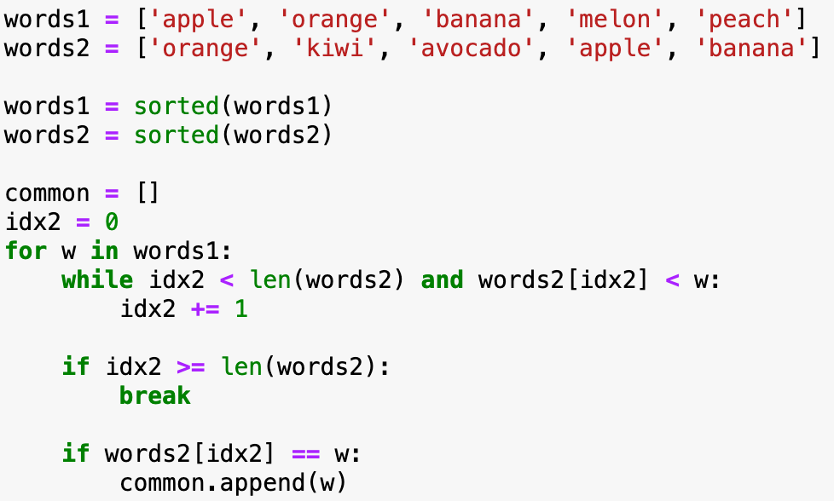

Implementation with sorted lists
What is the big-O complexity of this implementation?

Slide 15
Implementation with sorted lists
VM : FORMAT FORMULAS so that they are easier to read
What is the big-O complexity of this implementation?
2 * sorting + traversing two lists = 2*n log n + 2*n ~ O(n * log n)

Slide 16
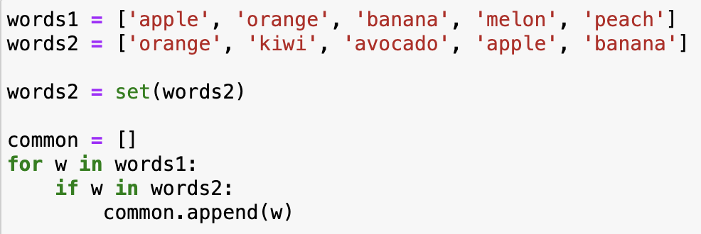
Implementation with sets
What is the big-O complexity of this implementation?

Slide 17
Implementation with sets
What is the big-O complexity of this implementation?
transforming one list to set + 1 for loop = 2 * n ~ O(n)
It’s the exact same code as for lists, but now looking up an element in sets (if w in words2) takes constant time!
How could you have known that set lookup is fast? Learning about data structures!
VM : FORMAT FORMULAS so that they are easier to read

Slide 18
Basic information about Python data structures
lists: collection of ordered, arbitrary data
getting an element by index: O(1)
appending: O(1)
inserting an element: O(n)
sorting: O(n * log n)
finding an element (e.g., ”if element in my_list: …”): O(n)
dictionaries (”hashmaps”)
inserting: O(1)
finding element by key: O(1)
sets (it’s just dictionaries without values)
inserting: O(1)
finding an element (e.g., ”if element in my_set: …”): O(1)
Notes:
Note that there may be different implementations of these data structures with different complexities, these are for the Python implementation.
E.g., if finding an element in a list is important, one could implement it as two dictionaries, one mapping indices to data, one mapping data to indices. Finding out the complexities of all the operations with this implementation is left as a homework.

Slide 19
Exercise
VM: THIS MIGHT BE TOO DIFFICULT, we need to find another one
You are given a long list of English words
The goal is to find all the anagrams of an input word
What data structure to use for the list of words?
Write the algorithm
What is the Big-O class of your algorithm?

Slide 20
NUMPY

Slide 21
NumPy – huh, yeah – what’s it good for?
NumPy’s main contribution is to introduce new data structure: the array
An array could be represented as a list-of-lists.
Thinking back to Tiziano’s class, why are NumPy arrays better than a list-of-lists?
An array is a regular, N-dimensional grid of data of the same type, typically numerical data

Slide 22
Why are NumPy arrays efficient?
Memory efficient: The data occupies the minimum amount of memory required; some operations can be done without touching the memory at all!
Fast: Many operations can be done very efficiently in C. For this to be useful, we need to avoid Python for-loops at all costs! We say we need to “vectorize” the code

Slide 23
NumPy’s memory efficiency

Slide 24
Memory block
The array data is stored in a contiguous memory block, using native data types
0 | 1 | 2 | 3 | 4 | 5 | 6 | 7 | 8
int64

Slide 25
Memory block
Metadata tells NumPy how to interpret the memory block
0 | 1 | 2 | 3 | 4 | 5 | 6 | 7 | 8
int64
8 bytes
24 bytes
NumPy array metadata
dtype | int64
ndim | 2
shape | (3, 3)
strides | (24, 8)

Slide 26
Memory block
Metadata tells NumPy how to interpret the memory block
0 | 1 | 2 | 3 | 4 | 5 | 6 | 7 | 8
int64
8 bytes
24 bytes
NumPy array metadata
NumPy view
dtype | int64
ndim | 2
shape | (3, 3)
strides | (24, 8)
0 | 1 | 2
3 | 4 | 5
6 | 7 | 8

Slide 27
Memory block
0 | 1 | 2 | 3 | 4 | 5 | 6 | 7 | 8
The same memory block can be interpreted in many ways
NumPy array metadata
NumPy view
dtype | int64
ndim | 2
shape | (3, 3)
strides | (24, 8)
0 | 1 | 2
3 | 4 | 5
6 | 7 | 8
dtype | int64
ndim | 1
shape | (9,)
strides | (8,)
0 | 1 | 2 | 3 | 4 | 5 | 6 | 7 | 8
dtype | int64
ndim | 2
shape | (3, 3)
strides | (8, 24)
0 | 3 | 6
1 | 4 | 7
2 | 5 | 8
dtype | int64
ndim | 2
shape | (2, 2)
strides | (48, 16)
0 | 2
6 | 8

Slide 28
Memory block
Which is why some NumPy operations are super efficient, O(1): they only modify the metadata
0 | 1 | 2 | 3 | 4 | 5 | 6 | 7 | 8
NumPy array metadata
NumPy view
NumPy operation
dtype | int64
ndim | 2
shape | (3, 3)
strides | (24, 8)
0 | 1 | 2
3 | 4 | 5
6 | 7 | 8
x
dtype | int64
ndim | 1
shape | (9,)
strides | (8,)
0 | 1 | 2 | 3 | 4 | 5 | 6 | 7 | 8
x.ravel()
dtype | int64
ndim | 2
shape | (3, 3)
strides | (8, 24)
0 | 3 | 6
1 | 4 | 7
2 | 5 | 8
x.T
dtype | int64
ndim | 2
shape | (2, 2)
strides | (48, 16)
0 | 2
6 | 8
x[::2, ::2]

Slide 29
Operations that only change the metadata return a view, otherwise a new memory block needs to be allocated and they return a copy
Live: notebooks/numpy_views_and_copys

Slide 30
Hands-on: view or copy? If view, how is the metadata changed?
Notebook: view_or_copy
Operation | View?
x[::2, :]
x[1, :]
x[1]
x[[1, 2, 0], [1, 1, 2]]
x[[0, 2], :]
x.reshape((6, 2))
x.ravel()
x.T.ravel()
x[(x % 2) == 1]
y = x + 2
y = np.sort(x, axis=1)
x
0 | 1 | 2 | 3
4 | 5 | 6 | 7
8 | 9 | 10 | 11

Slide 31
A special kind of view: broadcasting operations
Memory block
0 | 1 | 2 | 3 | 4 | 5 | 6 | 7 | 8
NumPy array metadata
dtype | int64
ndim | 2
shape | (4, 9)
strides | (0, 8)
The shape says we have 4 rows and 9 columns
A stride of 0 means that for each new row, we don’t move in memory

Slide 32
A special kind of view: broadcasting operations
Memory block
As a result, we obtain a view with duplicated rows, without using extra memory!
0 | 1 | 2 | 3 | 4 | 5 | 6 | 7 | 8
NumPy array metadata
NumPy view
dtype | int64
ndim | 2
shape | (4, 9)
strides | (0, 8)
The shape says we have 4 rows and 9 columns
0 | 1 | 2 | 3 | 4 | 5 | 6 | 7 | 8
0 | 1 | 2 | 3 | 4 | 5 | 6 | 7 | 8
0 | 1 | 2 | 3 | 4 | 5 | 6 | 7 | 8
0 | 1 | 2 | 3 | 4 | 5 | 6 | 7 | 8
A stride of 0 means that for each new row, we don’t move in memory

Slide 33
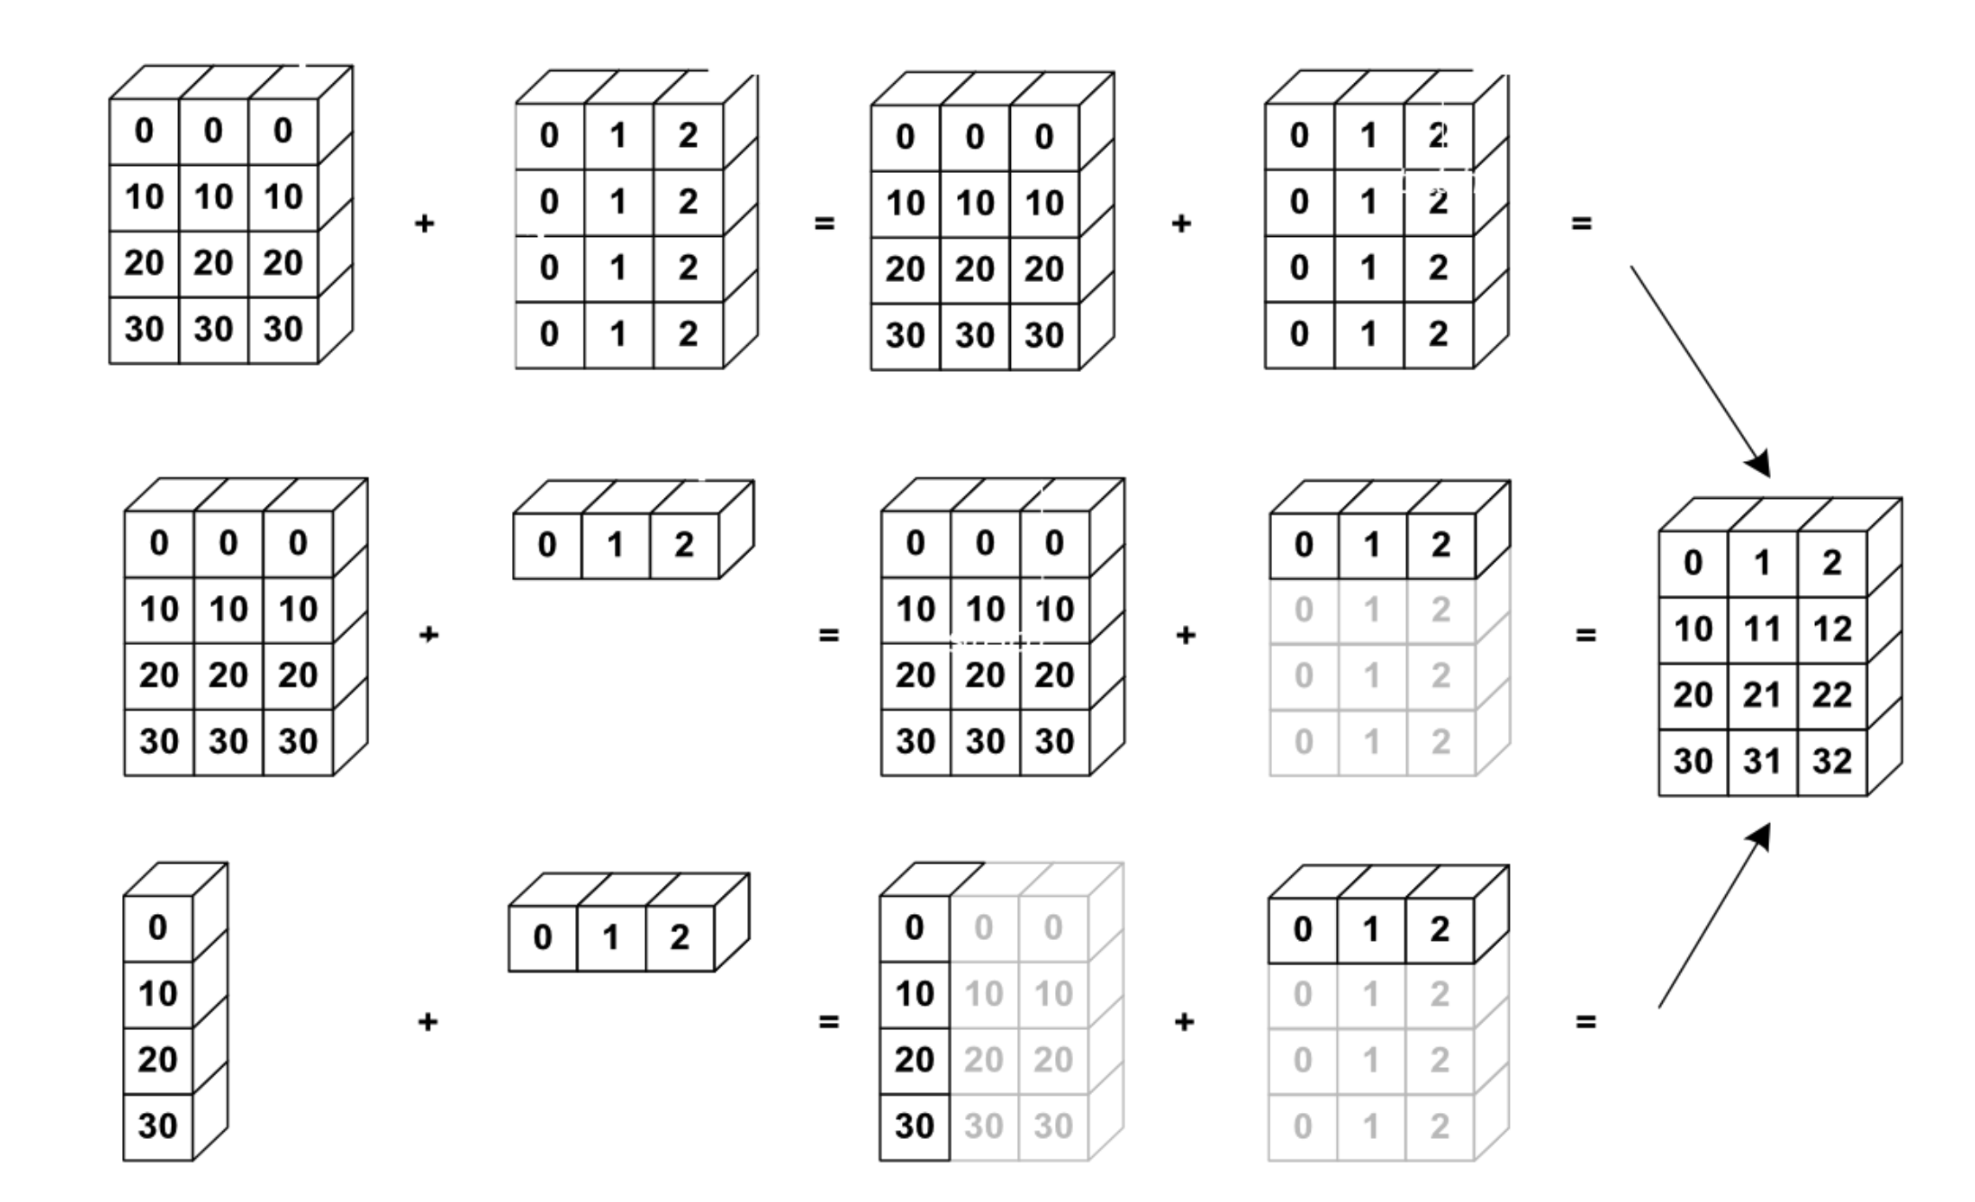
NumPy uses broadcasting to perform operation on arrays of different shape without having to allocate extra memory

Slide 34
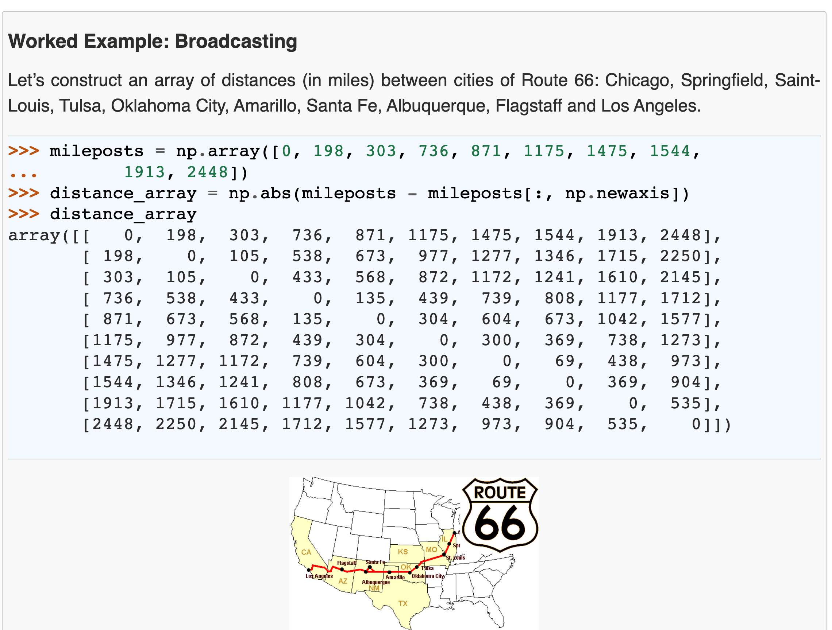

Slide 35
NumPy’s speed efficiency

Slide 36
For loops in C
Show how a numpy operation can be executed very fast in C
Related to memory: the data is of a C numerical type, and the layout is regular in memory. A C loop can jump from one memory location to the next by moving by “strides” bytes and accumulating the result
To get that performance, one needs to vectorize! it’s important to avoid for-loops at all costs
Question: How is efficiency of Python vs C in the Big-O sense?

Slide 37
Here list useful NumPy functions that help vectorize for-loop code
VM
Make a reference slide with useful things to vectorize for-loops
broadcasting
mgrid
…
Find a couple of nice examples where complicated for-loop code is nicely vectorized

Slide 38
Exercise: give python code with for-loops and ask them to vectorize
proposal for exercise: numpy_vectorize

Slide 39
Beyond memory (briefly, optional, probably skip)
Use memmap with NumPy (keep large array data on disk)
HFD-5 (keep large array data on disk , block-order, example from geophysics project)
blosc (compressed data) -> maybe do not present, never seen anyone use it

Slide 40
HERE INSERT Tabular Data SLIDES

Slide 41
Thank you!

Slide 43
Data class outline
TO BE REMOVED
Introduction
what data structures do you know? list, dictionary, set, tree, graph, array, database, …
you could store data in a dictionary as a list — what makes you choose a data structure over another? speed (dictionary retrieval O(1), list O(n), demo this) memory (on disk, in memory)
for what kind of data is each of the data structure good? list, dictionary … numpy array -> n-d grid of data of the same basic type; efficient use of memory and for loops implemented at C-level for some operations pandas DataFrame -> records of different types, e.g. info about experiment subscriber, experiment results by subscriber and condition, … ; efficient operations on columns; easy statistics and analytics on groups
homogeneous array data: numpy
only small changes to numpy class to stress the overall topics
one thing I suggest to add: memmap. What does it do, how much in this case it’s important to think about the operations we want to do on the array: view vs copy; random sampling is going to load all of the memory pages the samples are in. Even C- and Fortran-order are going to have a different impact on memory usage
mention that HDF5 can also be used for efficient on-disk storage of array data
heterogeneous, column-based data with index: pandas
the topics of this part apply to pandas, spark, SQL databases, dask, … : they all share the same basic concepts; we’ll use pandas for convenience
“tidy data” ideas
just as in numpy, avoiding for loops is critical for both memory and speed consumption
split, map, aggregate -> basic ideas, related to tidy data; summary tables, pivots
joins and anti-joins: basic and also how they can make some filtering cases easy, without for loops
window functions
coalescing: selecting one of several computations based on priority (eliminates if .. else mapping)
briefly discuss strengths of pandas, spark, SQL databases, dask
(possibly) data organization topics
data processing stages
handling changes in the data
missing values

Slide 44
Goals (will be removed)
TO BE REMOVED
Goals:
Brief introduction to data structures
why are there many? what are the trade-offs? Basic facts about Python lists, sets, and dictionaries (exercise)
arrays, grid of homogeneous data (numpy)
efficient storage in memory, interpretation layer, and C-level loops
knowing this makes it easy to understand: view vs copy; when is C- or F-order better
off-memory array: memmaps, HDF5 (and beyond C- and F-order, example 3D geodata)
blosc: memory-compressed arrays
tables, indexed columns of inhomogeneous data (pandas, dask, sql, …)

Slide 45
TO BE REMOVED
Part 1: data structures
which data structures exist?
which ones do we use most commonly in research? array, tables
why do we have many?
access time, memory, and algorithms (exercise)
Part 2: arrays (numpy)
why is it efficient? separate storage in memory from interpretation; copy vs view; broadcasting
it’s only efficient if you don’t do for loops: the for loops are done in the native C
exercises for that
memory maps -> on-disk arrays
HDF5 -> on-disk, chunked arrays
more: compressed storage (blosc)
Part 3: tables (pandas, dask, SQL, …)
calculations are done by column, rows have index
it’s only efficient if you don’t do for loops: split-group-appy, join, window functions
exercises for that
concept of “tidy data”, show example of difficult operation on table that becomes easy with tidy data

Slide 46
Data types
TO BE REMOVED
obvious but: different data structures are for storing different things
lists: sequences, ordered items -> stack, queue; sorted search
sets: bunch of items, no order
dictionaries: key-value
what’s maybe not obvious is that these data structures are specialized because they have speed or memory advantages
Q: what is the time to retrieve an item from a list? from a dictionary? from a set?
Numpy also is a specialized data structure
Q (exercise): what data structure would you use to represent
a graph? A: either a dictionary or a numpy array (adjacency matrix)
a sound wave?
have a look at Advent of Code to find other examples
Notes:
Bugs are inevitable

Slide 47
All the data structures
list: ordered, heterogeneous storage, stack/queue, fast access by index, slow search
set: unordered
dictionary
arrays: e.g. numpy, HDF5
tables: e.g. pandas, dask, spark, SQL
graph: social network structure
tree: to rapidly search a dataset
heap
stack
queue
priority queue

Slide 48
Data structures
TO BE REMOVED
You might know the native Python data structures (ask which ones): lists, tuples, sets, and dictionaries
There are also other data structures in the standard libraries
There is a whole theory of data structures
For example:
queue
priority queues
I want to give a taste of how to think about data structures:
what is stored
what are the operations that can be done on them
how they are implemented and how efficient that is, is another matter (e.g. representation of graphs in matrices vs dictionaries)
you don’t need to know the implementation, just the efficiency of each operation

Slide 49
Lists
Content: ordered sequence on items, any data type
Operations (subset):
append
insert
“is in”
search sorted
Implementations can be different!
Python list
Linked list
numpy array
Guess the complexity
Note that a numpy array is similar, but “append” is linear

Slide 50
For example:
Accumulating results in a list vs a numpy array
list: 2*n -> O(n)
array: n * (n – 1) / 2 -> O(n^2)

Slide 51
Dictionaries (“hashmap”)
Content: unordered collection of key-value pairs
Operations:
insert
delete
is in
sets are the same but without value

Slide 52
Hands on: Connecting the dots with the computer architecture class
We want to compute the sum of all elements of a sliced array, x[::step_i, ::step_j].sum() Discuss the memory and speed efficiency of this expression
Think about Verjinia and Tiziano’s architecture class
Is there any scenario where creating a copy of the sliced array could improve efficiency? x[::step_i, ::step_j].copy().sum()
I think this exercise does not make sense

